Slide 1
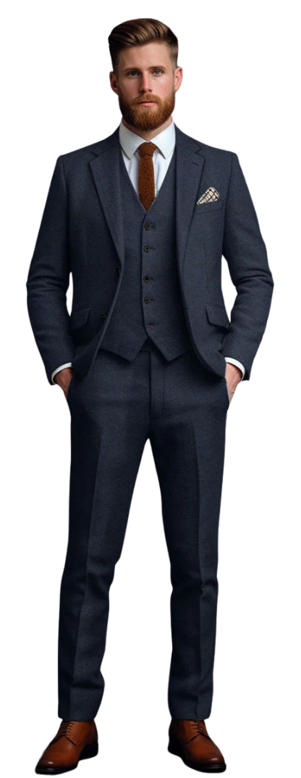
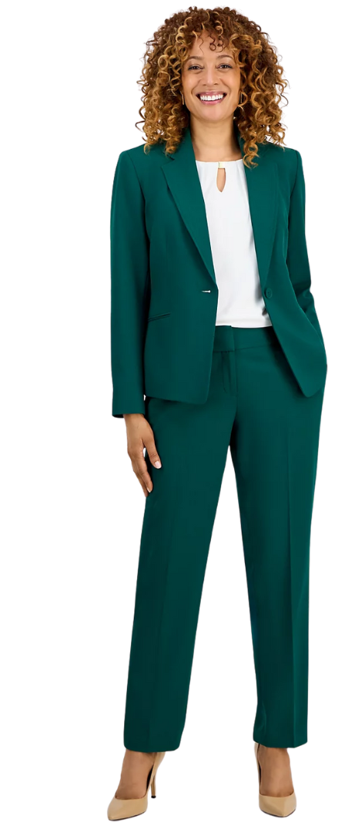
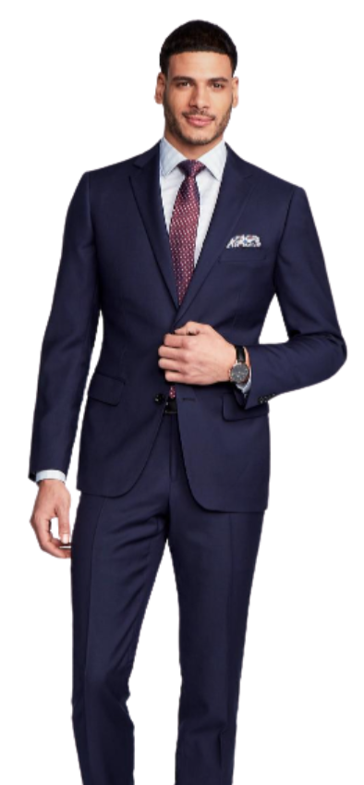
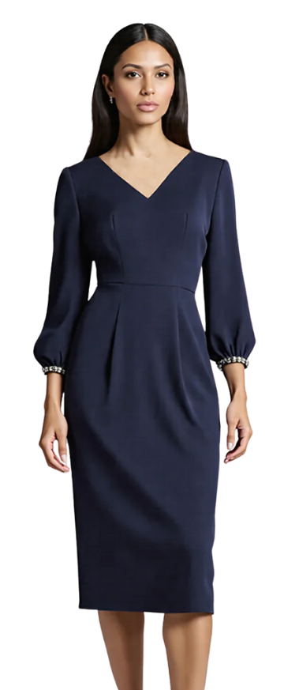
Business
Classic CEO style. Polished, elevated, and appropriate for business leaders.
What to wear:
✔ Suit jacket and tie
✔ Dress shirt or blouse
✔ Dress pants, skirt, or business dress
✔ Polished shoes such as heels, flats, loafers, or oxfords
What not to wear:
✘ Casual clothing (jeans, t-shirts)
✘ Sneakers or overly casual footwear
Notes:
Business attire includes a suit jacket with tie, dress shirt or blouse, and tailored dress pants, skirt, or business dress. Polished footwear such as heels, flats, loafers, or oxfords completes the professional, CEO-ready style.

Slide 2
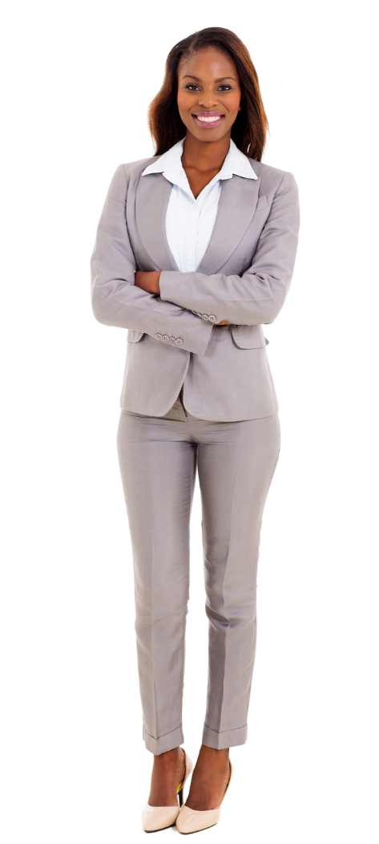
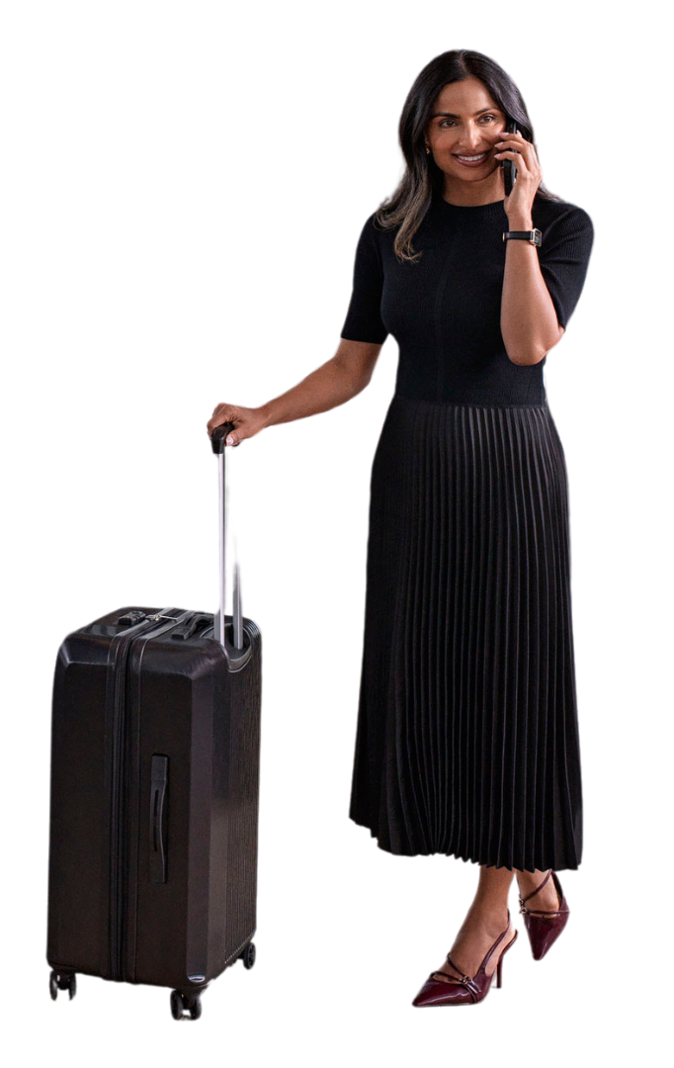
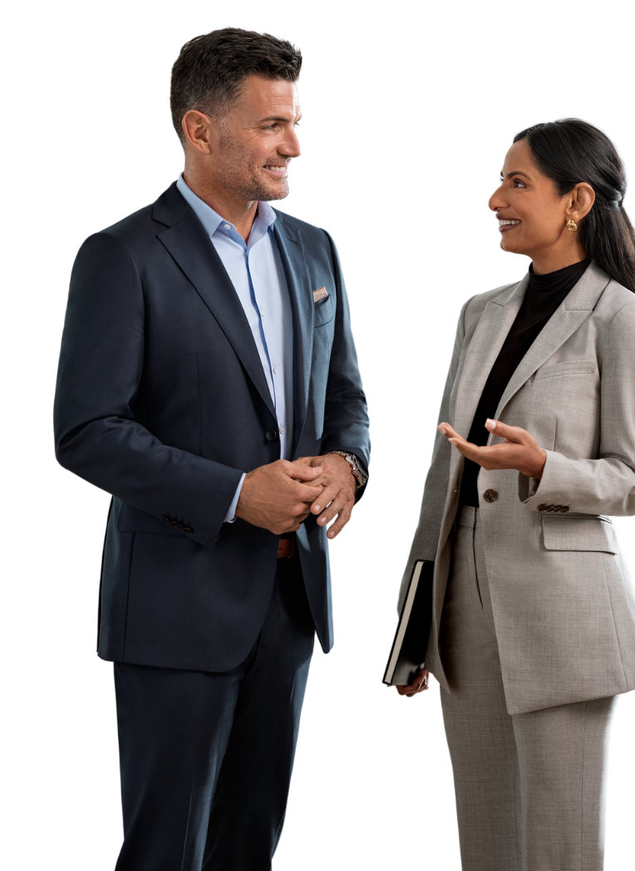
Business
(no-tie)
Slightly less formal than business, but still polished.
What to wear:
✔ Suit jacket
✔ Dress shirt (no tie) or blouse
✔ Dress pants, dress, or skirt
✔ Heels, flats, loafers, or oxfords
What not to wear:
✘ Jeans
✘ Exercise Sneakers
Notes:
Business (no tie)
Examples of business casual clothing include suit jacket, dress shirt (no tie), blouse, dress pants, dress, or skirts. Shoes can consist of heels, flats, loafers, or oxfords.

Slide 3
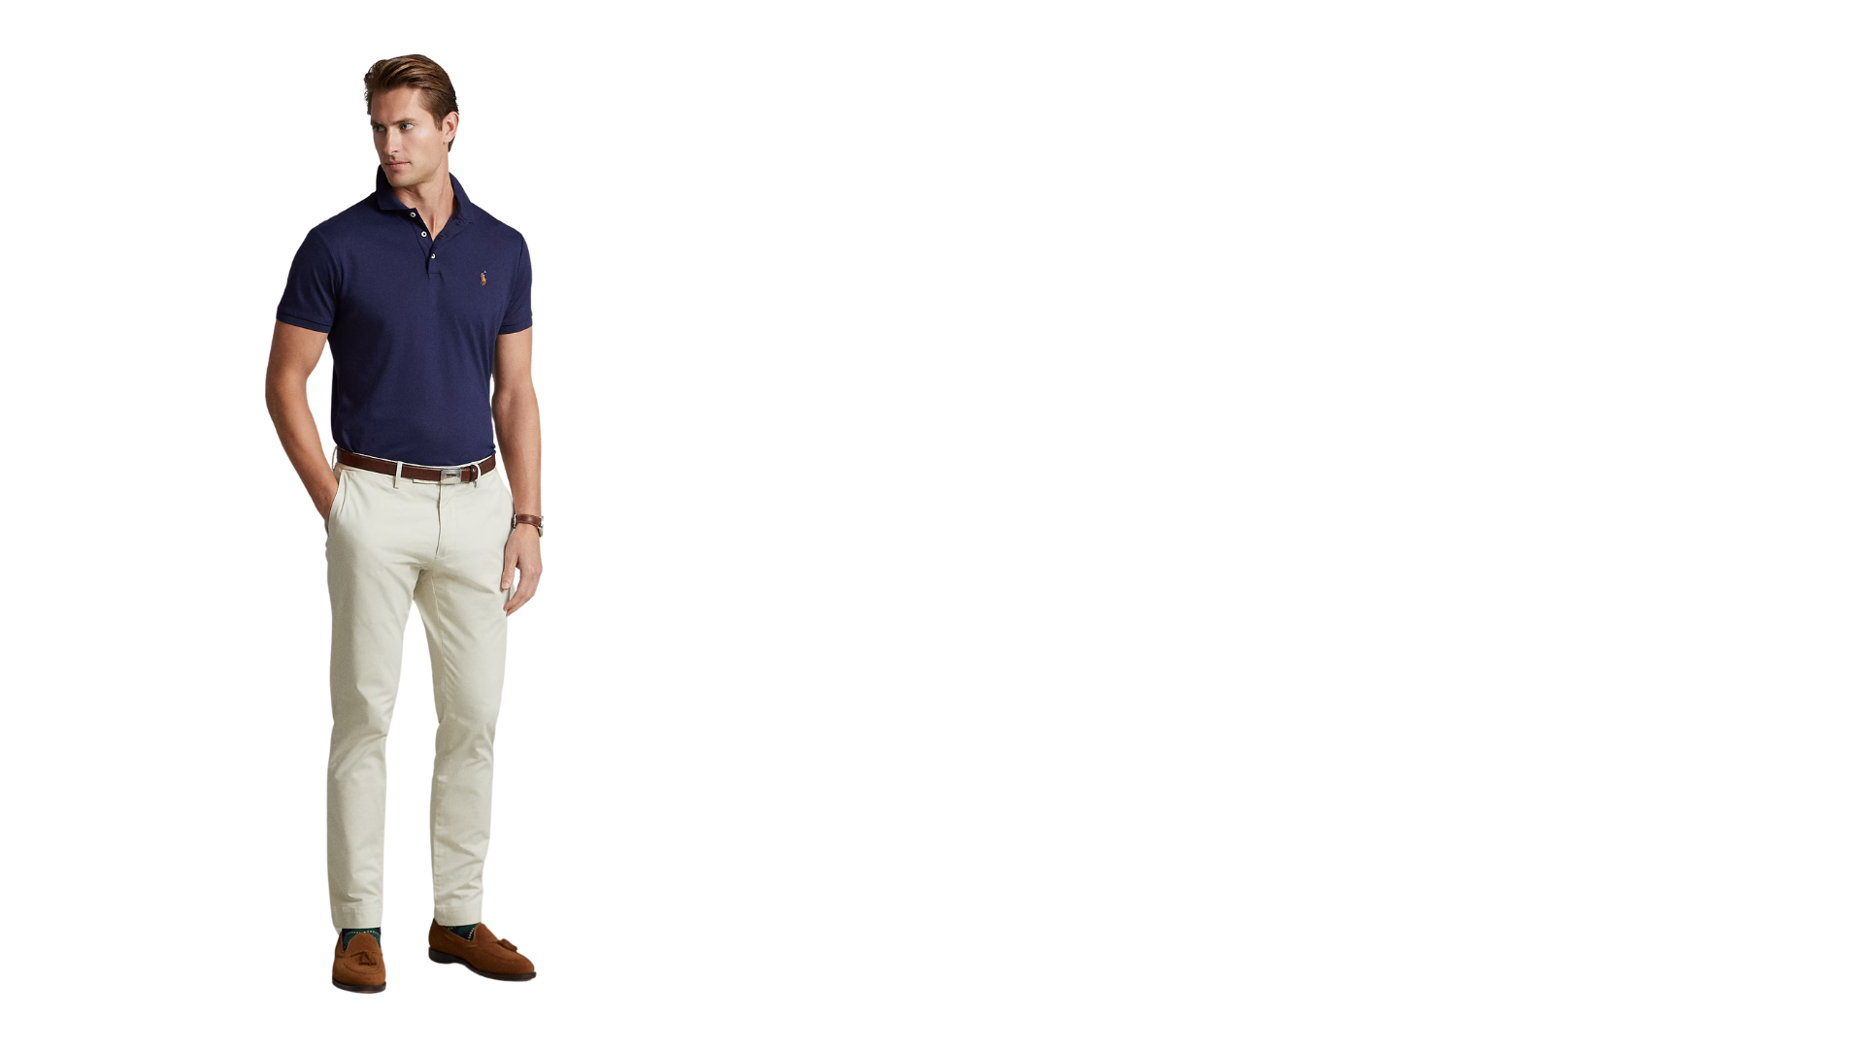
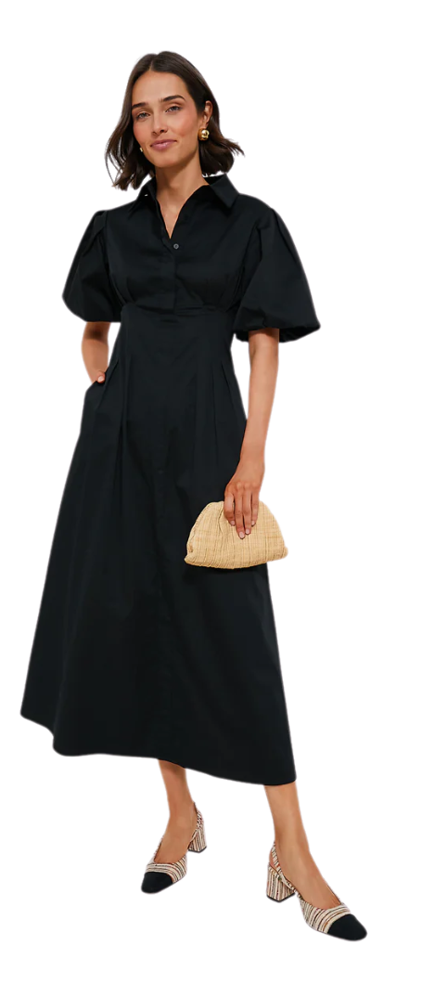
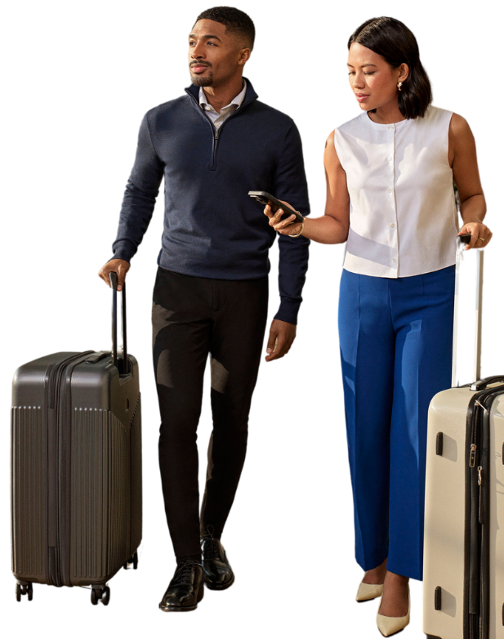

Business casual
A balanced mix of professionalism
and comfort.
What to wear:
✔ Work appropriate shirt or blouse
✔ Dress pants, dress, or skirt
✔ Nice jeans
✔ Loafers, flats, heels, hip sneakers, or boots
What not to wear:
✘ Athleisure, shorts, or leggings
✘ Sandals or exercise Sneakers
Notes:
Business Casual
Examples of business casual clothing include dress pants, chinos, skirts, blouses, collared shirt, polo shirts, and sweaters, optionally paired with blazers or sport coats. Shoes can include loafers, flats, dress boots, or heels, while overly casual footwear such as flip-flops or athletic sneakers should be avoided.

Slide 4
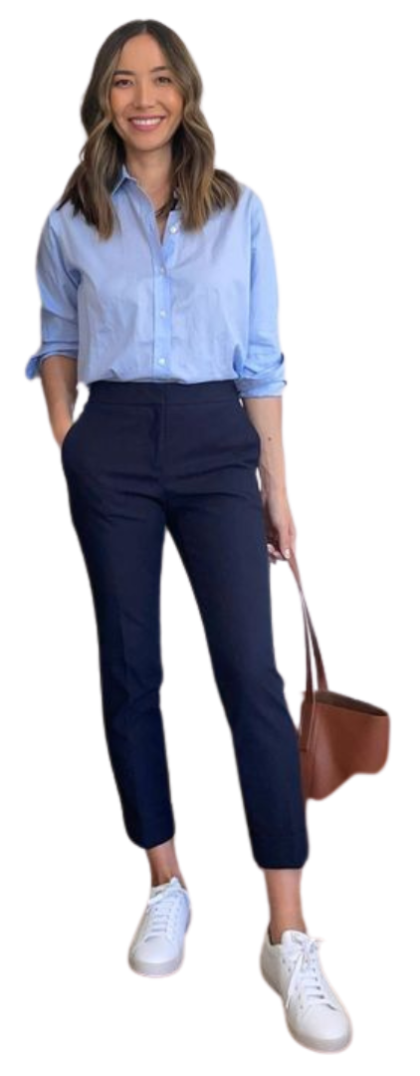
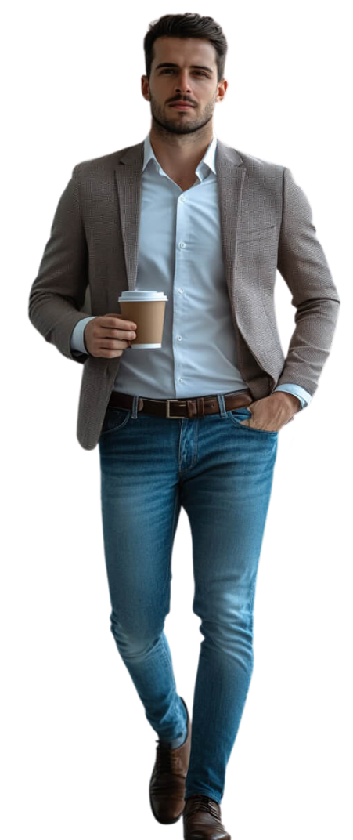
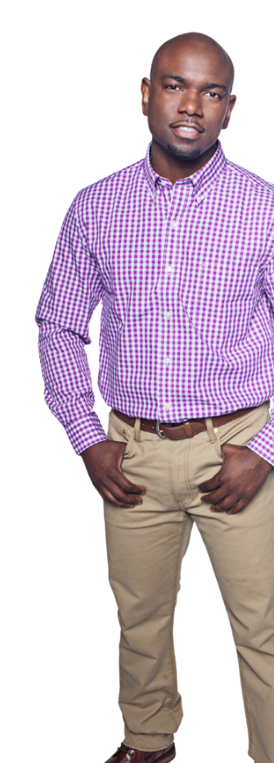
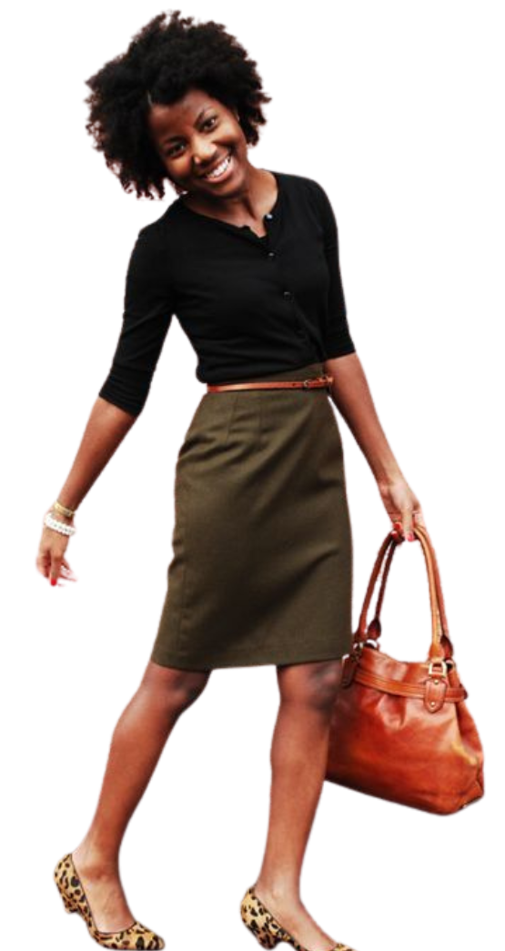
Casual
A relaxed yet polished look that prioritizes comfort.
What to wear:
✔ Work appropriate shirt or blouse
✔ Skirt, dress, or cropped pants
✔ Nice jeans, khakis, or linen pants
✔ Loafers, flats, low heels, hip sneakers, or sandals
What not to wear:
✘ Athleisure, gym wear, or sweatpants
✘ Flip-flops or athletic sneakers
Notes:
Casual
Casual dress includes polo shirts, button-down shirts, blouses, and sweaters on top. Bottoms might include jeans, khakis, linen pants, and cropped pants. Casual shoes can incorporate loafers, low heels, or sandals.

Slide 5
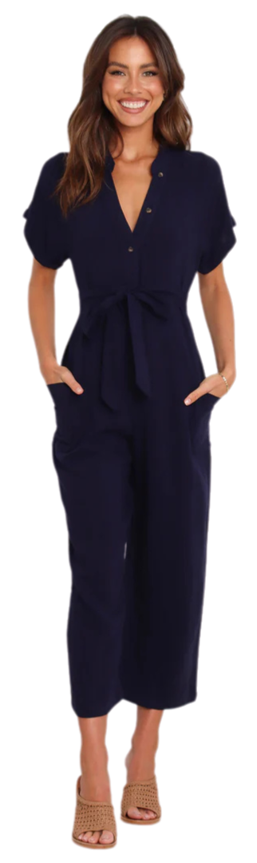
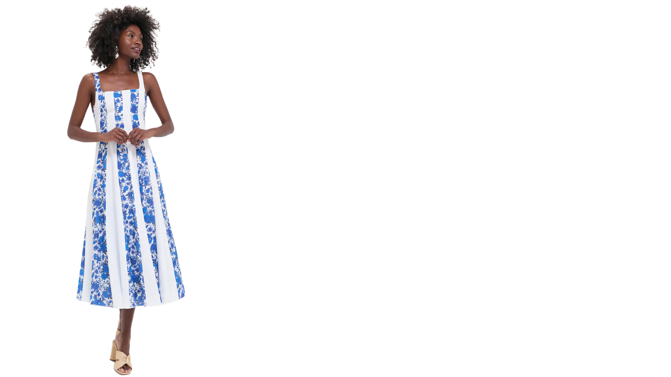
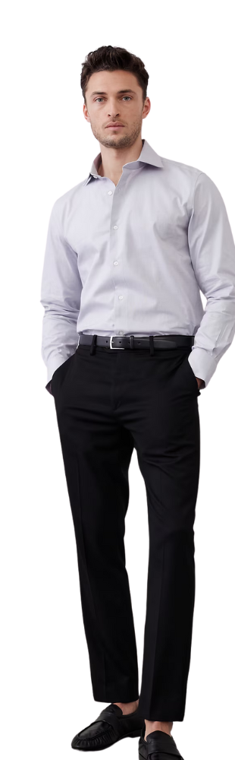
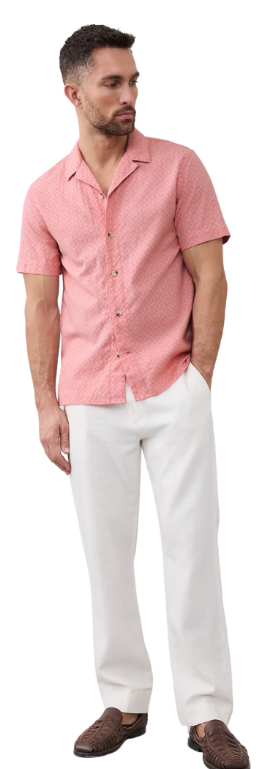
Resort dress
Polished and effortless, for a relaxed yet refined setting.
What to wear:
✔ Collared shirts or stylish blouses
✔ Dresses, skirts, or jumpsuits
✔ Slacks, khakis, or linen pants
✔ Dressier sandals, loafers, or closed-toe shoes
What not to wear:
✘ Athleisure, shorts, or sweatpants
✘ Flip-flops or athletic sneakers
Notes:
Resort Dress
A collared shirt or polo. Long pants like slacks or khakis, dresses of all kinds, skirts, jumpsuits, dressier sandals and shoes.

Slide 6
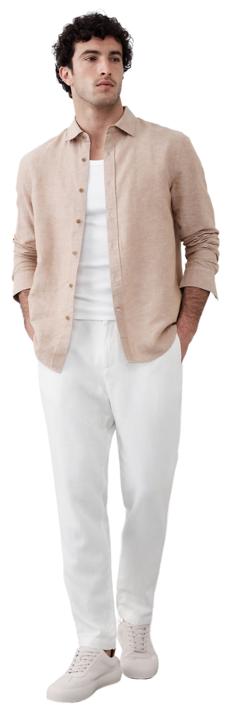
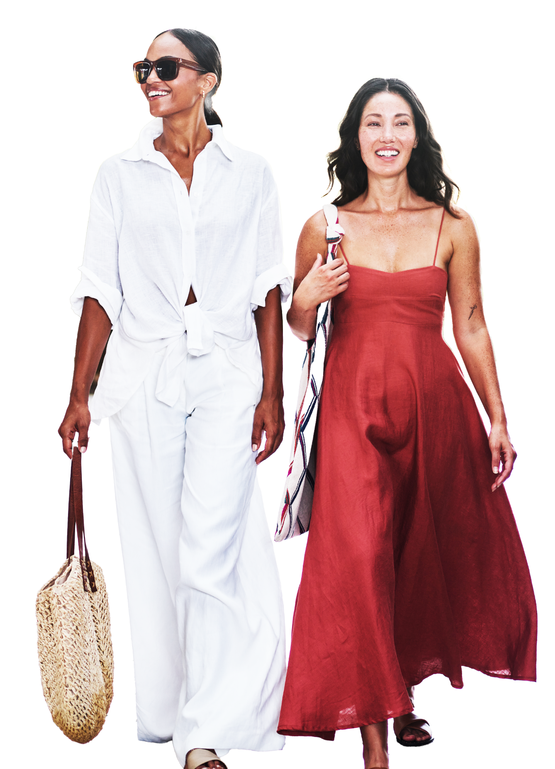
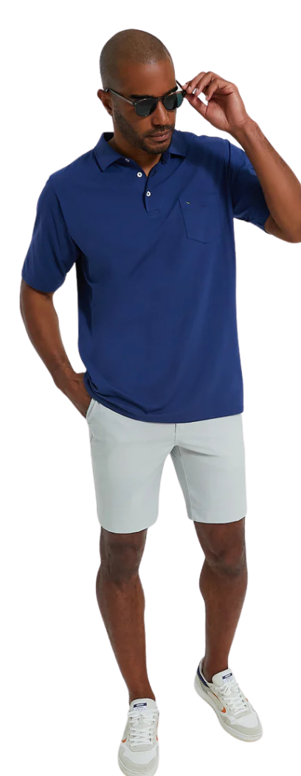
Resort casual
A relaxed blend of resort wear and casual comfort.
What to wear:
✔ Collared shirt, quality pullover top, or blouse
✔ Dresses, skirts, or skorts
✔ Khakis, linen pants, or tailored shorts
✔ Sandals, loafers, sneakers, or flats
What not to wear:
✘ Athleisure, gym wear, or sweatpants
✘ Flip-flops or athletic sneakers
Notes:
Resort Casual
Resort casual can encompass resort dress and casual wear, such as quality pullover shirts, collared shirt, blouse, skorts, skirts, dresses, shorts, sneakers, and sandals.

Slide 7
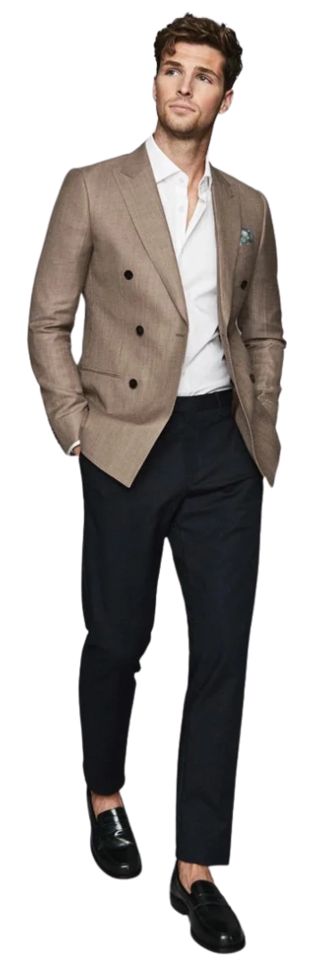
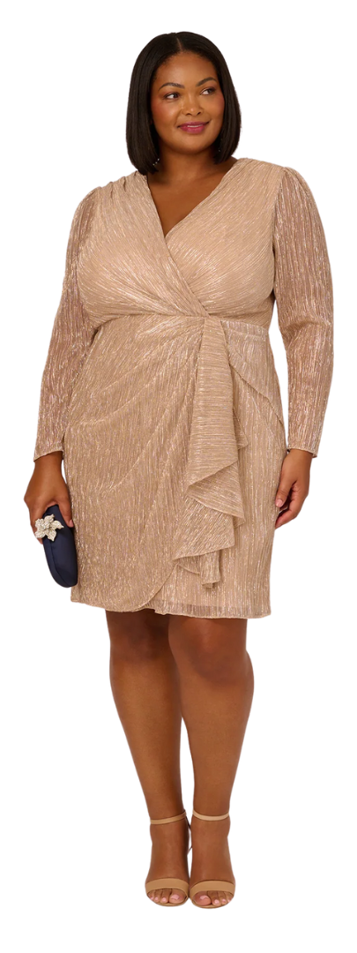
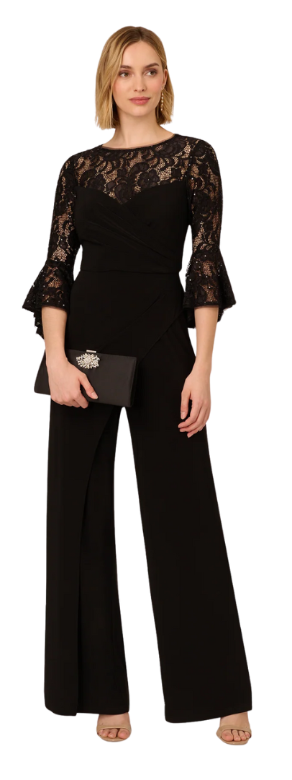
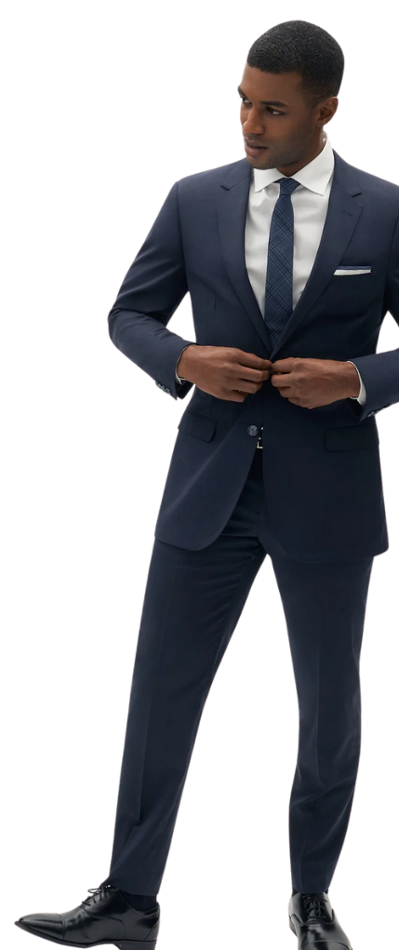
Cocktail
Sophisticated, stylish, dressy attire.
What to wear:
✔ Button-down shirt or blouse
✔ Dress pants, dress, or skirt
✔ Blazers for a polished touch
✔ Loafers, Heels, or dressy flats
What not to wear:
✘ Sneakers, polo, T-shirts, or jeans
✘ Too revealing or casual clothing
Notes:
Cocktail
Women can choose tailored dresses or blouses with skirts or slacks, while men should opt for a well-fitted suit or blazer. Finish the look with appropriate dress shoes or loafers. Avoid casual items like T-shirts or sneakers to maintain a refined appearance.

Slide 8
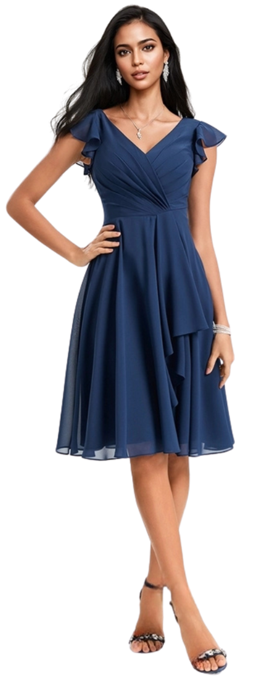
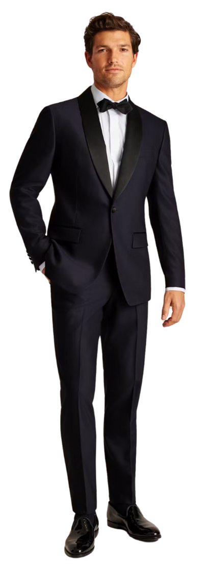
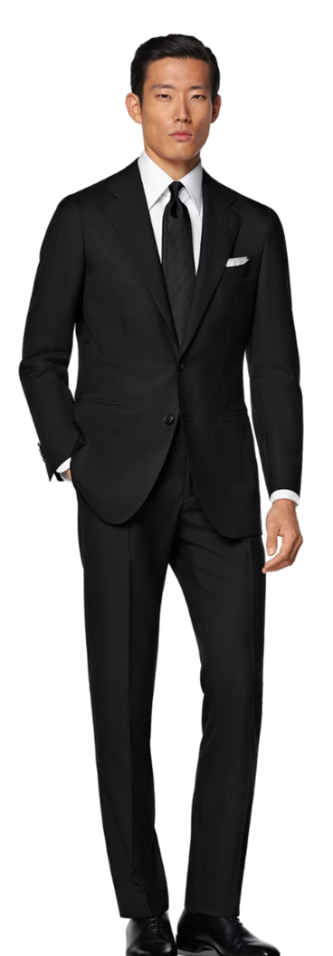
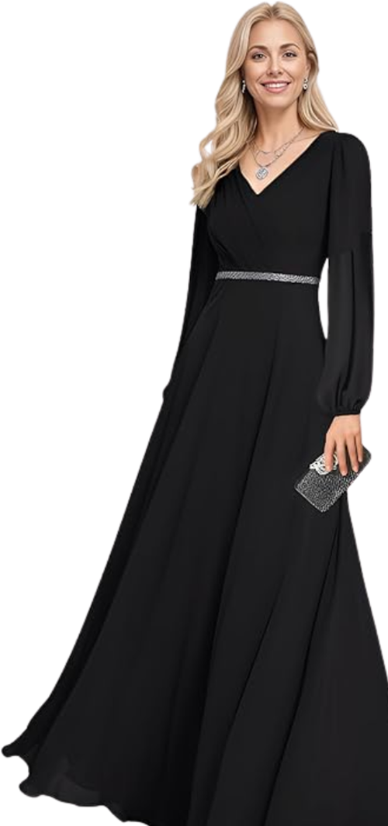
Formal
Black-tie, elegant, and polished.
What to wear:
✔ Floor-length gown or dressy cocktail dress
✔ Pantsuit in formal fabrics
✔ Dark suit with tie or tuxedo
✔ Polished dress shoes, heels, or dressy flats.
What not to wear:
✘ Casual fabrics like cotton or denim
✘ Anything too revealing or ill-fitting
Notes:
Formal
Formal attire calls for polished, elevated looks that reflect a sophisticated business setting. For women, this includes floor-length gowns or elegant cocktail dresses in refined fabrics, paired with understated jewelry and heels or dressy flats. Men should wear a dark suit and tie or a tuxedo with classic dress shoes.

Slide 9
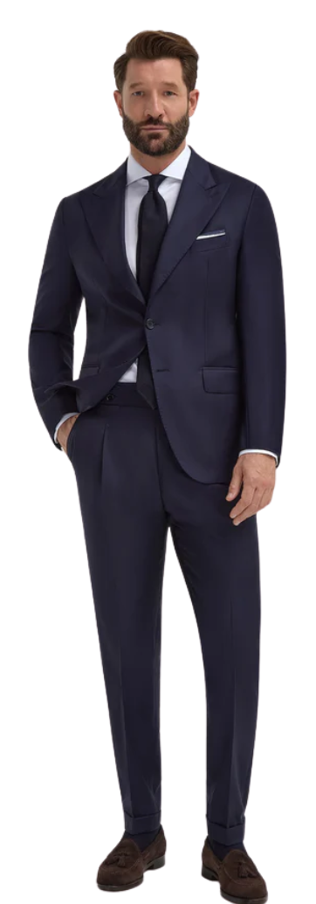
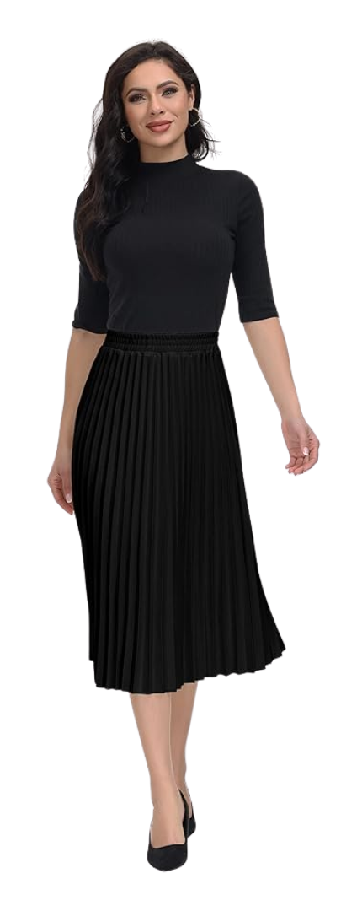
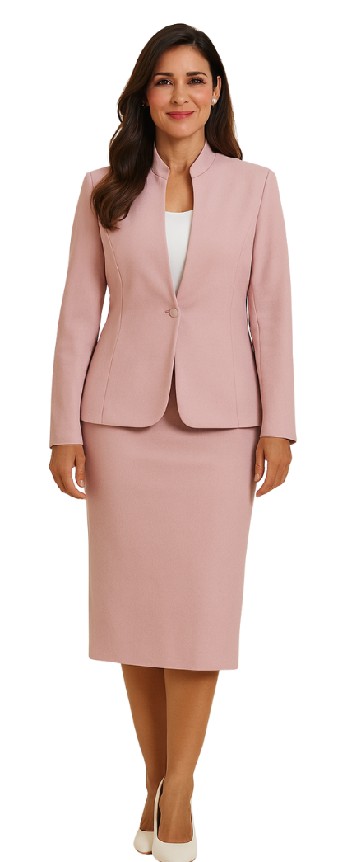
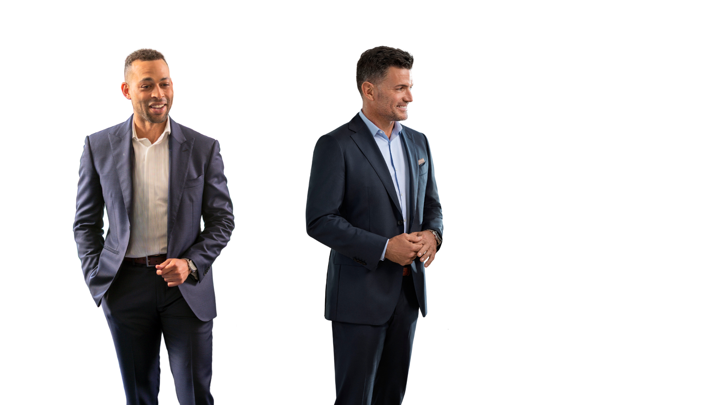
Stage Presenter
Dress so your content is the focus—not your clothing.
When you're on stage, hundreds of eyes are on you. Every detail of your appearance contributes to how your message is received. Choose attire that supports your executive presence, not distracts from it.
What to wear:
✔ Tailored suit, dress pants and shirt
✔ Blouse or shirt in opaque fabric
✔ Smoothing undergarments or undershirts
✔ Skirt or dress with a longer hemline
✔ Polished heels, flats, loafers or oxfords
What not to wear:
✘ Too tight or too short clothing.
✘ Sheer fabrics, which can be revealing under bright lights.
Pro tip: Ensure your outfit provides coverage, especially when seated during panel discussions.
Notes:
Stage Presenter
Examples of business attire include tailored suits with dress pants and shirts, blouses or shirts in opaque fabrics, smoothing undergarments or undershirts, skirts or dresses with longer hemlines, and polished shoes such as heels, flats, loafers, or oxfords.

